Slide 1
Smart Bridge using Arduino Uno
Presentation by:
Vaidehi sharma
Ankit kumar
Submitted to:
Dr. A .S Kang

Slide 2
Contents
About Project | Brief description about why we chose this project and details
Sample Image | Image of our prototype
Components description | brief discription of each components used while making this prototype
Circuit diagram and schematic | Presentation of circuit diagram and schematic behind project
Scope,objectives and Advantages | Scopes and objective of our prototype in real life
Application | Basic details application of projcet in real life.

Slide 3
About the project
Bridges are essential infrastructure that connects different areas and makes transportation more accessible. However, they can be challenging to maintain, especially when water levels increase due to heavy rainfall or floods. In such cases, bridges can become dangerous, causing traffic to come to a halt or even collapse.
To prevent this, We have developed an automatic height-adjusting bridge that can help maintain the safety of the bridge even during heavy rain or floods.
An automatic height-adjusting bridge is designed to maintain a safe height during heavy rain or floods.
It is equipped with a servo motor, which is connected to an Arduino board that controls its movements. The servo motor is attached to a ultra sonic sensor that raises or lowers the bridge's height based on Height of object moving on the water. The Arduino board receives input from a moisture sensor that detects the water level and sends signals to the servo motor to adjust the bridge's height.

Slide 4
Why smart Bridge?
On date March 26 2024,
A cargo ship crashed into the Francis Scott Key Bridge, sending it splashing into the harbor and killing six people.This happened due to the height of ship and out of sight of the pilot .
So while looking over its causes we came across idea such that this kind of incident wont ever occurs in future.
We came out with idea of ”SMART BRIDGE”.
Basically behind this project our main motivate is to prevent such events by making the part of bridge to increase its height while depending on the height of ships , cargos and other objects.
This projects is also useful in case of increases in water level which might cause flood and lead to accidents such as bridge collapse , taking life of people or might cause traffics over a brigde.

Slide 5
Sample image of prototype
IMAGE

Slide 6
Components discription
1.Arduino Uno
Arduino UNO is a microcontroller board based on the ATmega328P. It has 14 digital input/output pins (of which 6 can be used as PWM outputs), 6 analog inputs, a 16 MHz ceramic resonator, a USB connection, a power jack, an ICSP header and a reset button. It contains everything needed to support the microcontroller; simply connect it to a computer with a USB cable or power it with a AC-to-DC adapter or battery to get started.
In our project we used Arduino uno that take data from user and a sensor and compare the relation and results it as output to servo motor that helps in increasing the height of bridge depending on objects height.

Slide 7
2.Servo Motor
A servo motor is a self-contained electrical device, that rotate parts of a
machine with high efficiency and with great precision.
The output shaft of this motor can be moved to a particular angle, position
And velocity that a regular motor does not have.
The Servo Motor utilizes a regular motor and couples it with a sensor for
Positional feedback.
The controller is the most important part of the Servo Motor designed and
used specifically for this purpose.
The servo motor is a closed-loop mechanism that incorporates positional
feedback in order to control the rotational or linear speed and position.
The motor is controlled with an electric signal, either analog or digital, which
determines the amount of movement which represents the final command
position for the shaft.
In our Project we have used two servo motors connected at each end of
bridge such that when a ULTRA SONIC SENSOR reflects an result to
Arduino the servo motors rotate results in increase of height of bridge
edges.

Slide 8
3.Ultrasonic Distance Sensor (HC-SR04)
An HC-SR04 ultrasonic distance sensor actually consists of two ultrasonic transducers.
It is 4 pin device .
One acts as a transmitter that converts the electrical signal into 40 KHz ultrasonic sound pulses. The other acts as a receiver and listens for the transmitted pulses.
When the receiver receives these pulses, it produces an output pulse whose width is proportional to the distance of the object in front.
This sensor provides excellent non-contact range detection between 2 cm to 400 cm (~13 feet) with an accuracy of 3 mm.
In our project HC-SR04 is used to detect the height of object and distance of object from bridge which ultimately results to Arduino uno results in changes in height of bridges edges depending on sensors reflection.

Slide 9
4. Buzzer
An audio signaling device like a beeper or buzzer may be electromechanical
or piezoelectric or mechanical type. The main function of this is to convert the
signal from audio to sound. Generally, it is powered through DC voltage and used
in timers, alarm devices, printers, alarms, computers, etc. Based on the various
designs, it can generate different sounds like alarm, music, bell & siren.
It includes two pins namely positive and negative. The positive terminal of
this is represented with the ‘+’ symbol or a longer terminal. This terminal is
powered through 6Volts whereas the negative terminal is represented with
the ‘-‘symbol or short terminal and it is connected to the GND terminal.
When an object above the height of bridge is detected siren at the
buzzer is starts sounding results in warning symbol before increment
in height of bridge edges.

Slide 10
4. battery(Power supply)
We are using a power supply via 9volt battery .
This is enough to operate Arduino and other circuit components to operate in our prototype.
Also as a alternative we are providing a power supply through power chord adapter that converts AC to DC down to 5 to 9 volt supply.

Slide 11
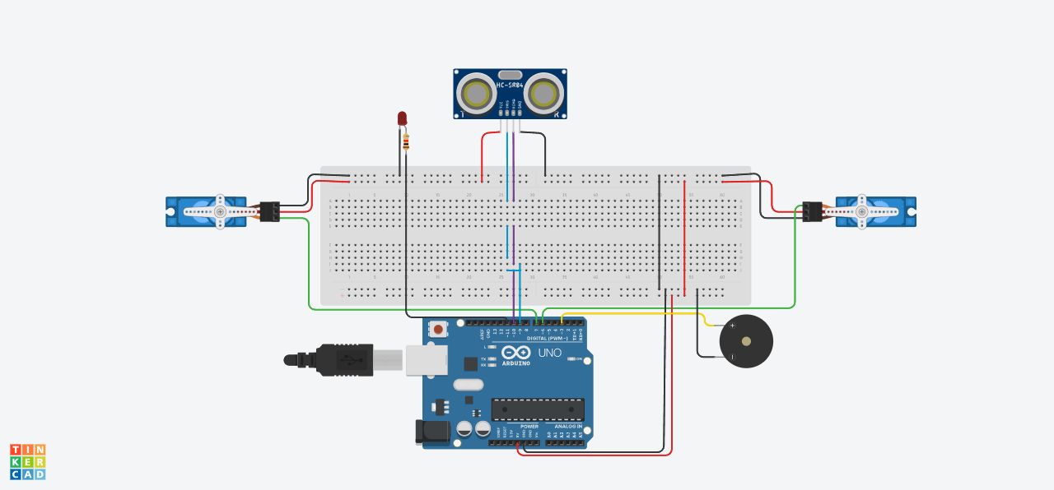
Circuit diagram
Ultrasonic distance sensor
LED
Servo Motor 1
Servo motor 2
Buzzer
Arduino uno r3

Slide 12
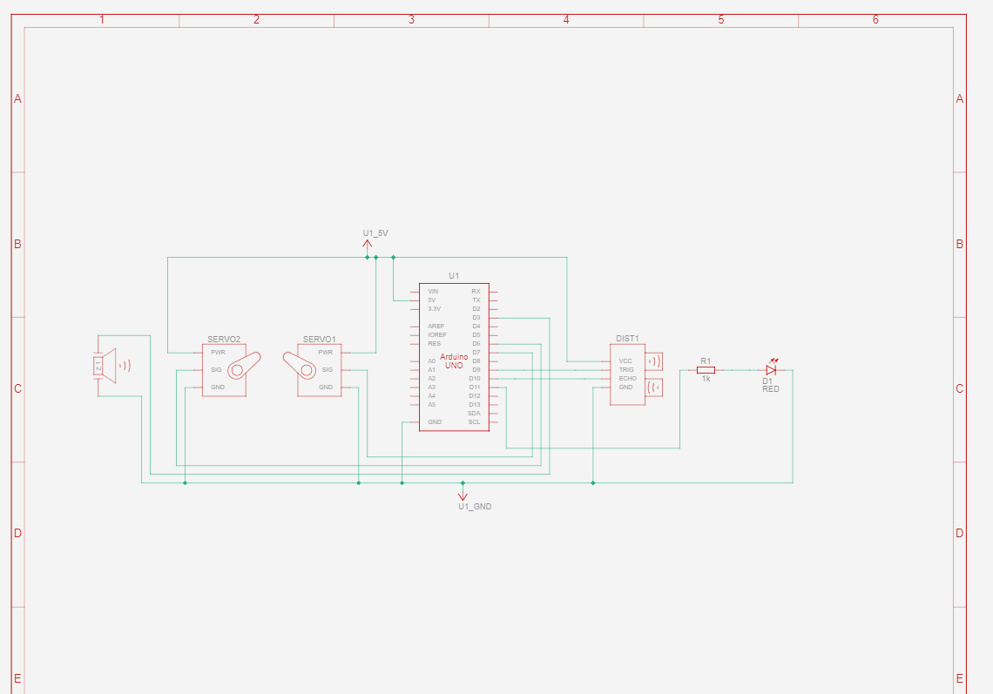
SCHEMATIC DIAGRAM

Slide 13
SCOPE
• System can be implemented at a global level in which different countries can manipulate data of their bridges at a single server.
• Implement on high cost suspension bridge.
• Monitoring Structural Performance and Applied Loads

Slide 14
OBJECTIVES
To provide security to all the users who are using it bridge
To provide reliability to the users
To maintain integrity of already built and old bridges in India
To help India for making it digitized
Smart city mission
To save the many lives
To save lives and property.
Take real time information of bridge.
It has safe and easy operations .
Provides smooth and accurate acceleration.
Quantity of materials can be reduced to construct bridge
ADVANTAGES

Slide 15

APPLICATIONS
To react timely.
• Work under an automated control system .
• And be able to collect information for making smart decisions .
•Water Level Monitoring & Emergency management.
Safety to human life and to prevent accidents.

Slide 16
Thank you!

